Slide 1










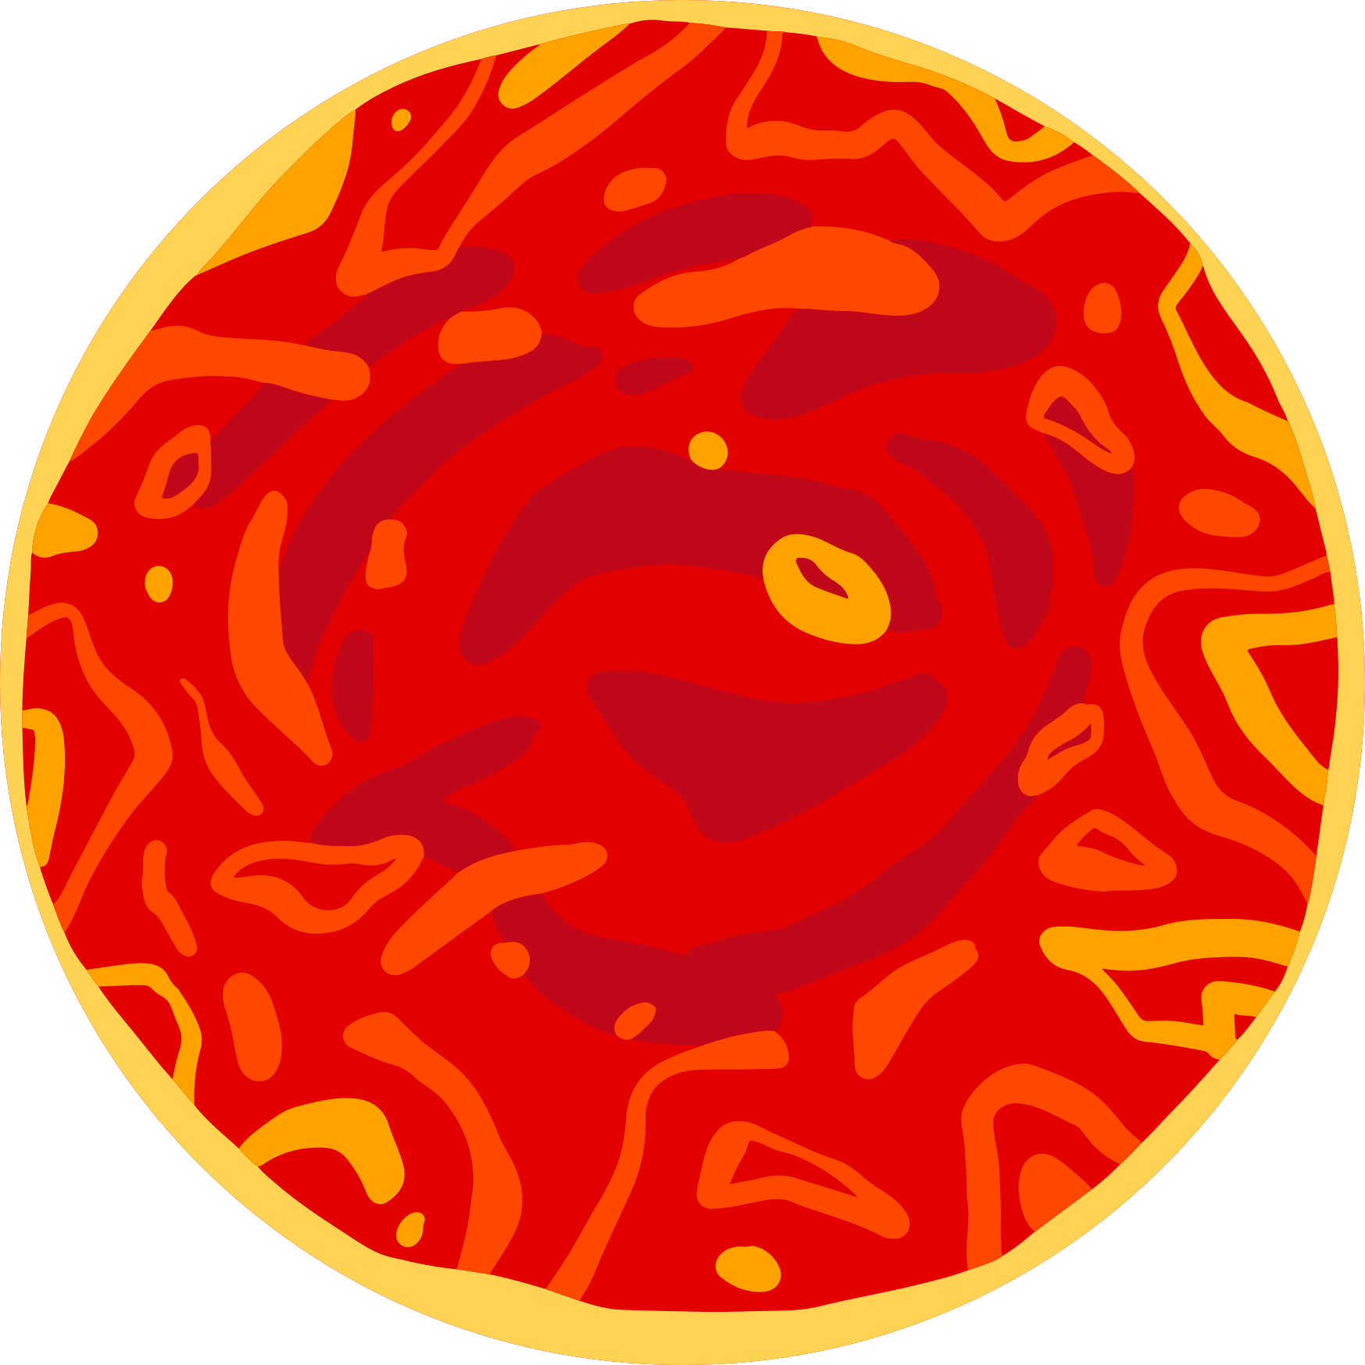



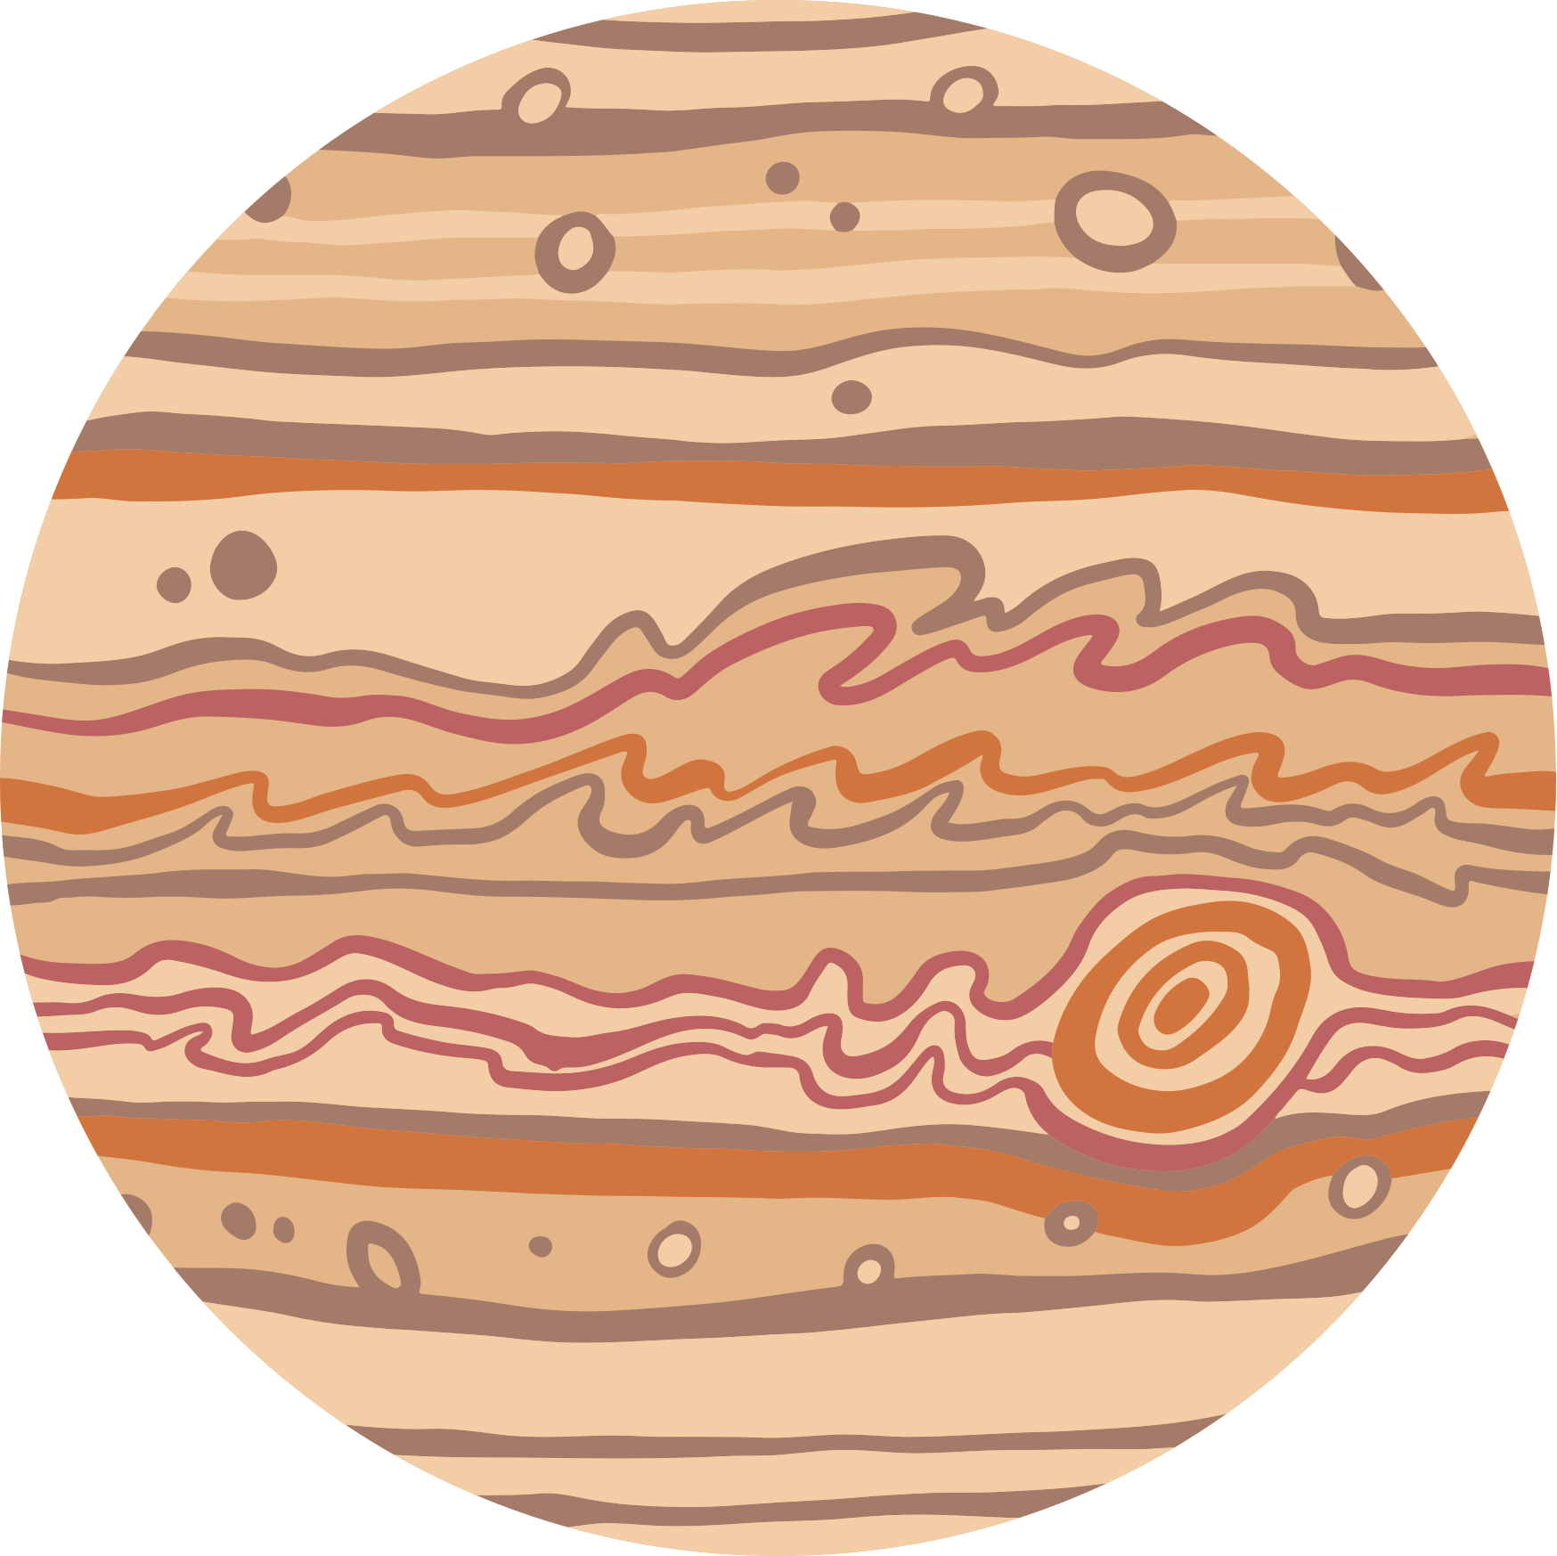



CODESPHERES
SHINGALA VRAJ
RANA PRARTHI
SHINGALA MANTHAN
PATEL DEV
MOTIVARAS AUM

Slide 2


METEOR MADNESS
Real-time data fetching of asteroid from NASA NEO API
Integrated this data with USGS geological data for predicting collision location
Calculation based on Kepler’s law, evaluate effects
Visual representation of impacting location of asteroid collision
Real time map visualization
User friendly interface

Slide 3
KEy features
Real-Time Meteor Detection
Continuously monitors and detects meteors and asteroids approaching Earth using real-time data and AI-based analysis.
Impact Area Estimation
Accurately predicts the potential area of impact and the radius of effect in case of an asteroid collision with Earth.
Disaster Impact Prediction
Analyzes possible aftermaths such as tsunamis, earthquakes, and other chain reactions, estimating the number of people likely to be affected globally.
Precise Trajectory & Collision Prediction
Utilizes Keplerian orbital formulas and advanced space mechanics to forecast the exact collision point and timing with high precision.

Slide 4
WORkflow
FETCH NEO DATA(API)
MAP VISULIZATION (IMPACT & ORBIT)
FETCH GEOLOGICAL DATA(USGS)
CALCULATE KEPLARIAN ORBITAL SCALE
INTERATE AND PROCESS DATA
RUN SIMULATION AND PREDICTION

Slide 5


tECH STACK
BACKEND : PYTHON, DJANGO
FRONTEND : HTML, CSS , JAVASCRIPT
API : NASA, USGS

Slide 6
Thank you !

